Slide 1
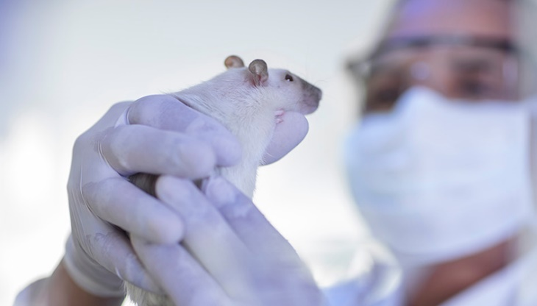
Cosmetics Testing on Animals
  Food and Drugs Act – prohibited for a person to:
  sell a cosmetic unless the person can establish the safety of the cosmetic without relying on data derived from a test conducted on an animal that could cause pain, suffering or injury, whether physical or mental, to the animal.
  conduct a test on an animal that could cause pain, suffering or injury, whether physical or mental, to the animal if the purpose of the test is to meet, with respect to a cosmetic, a requirement under a provision of this Act or the regulations or to meet a requirement that relates to the safety of cosmetics under the law that applies in a foreign state.
  make a claim on the label of or in an advertisement for a cosmetic that is likely to create an impression that the cosmetic was not tested on animals after the day on which this section comes into force unless the person has evidence that no such testing occurred after that day.
Presented by: Laura Gomez, Partner – laura.Gomez@gowlingwlg.com

Slide 2
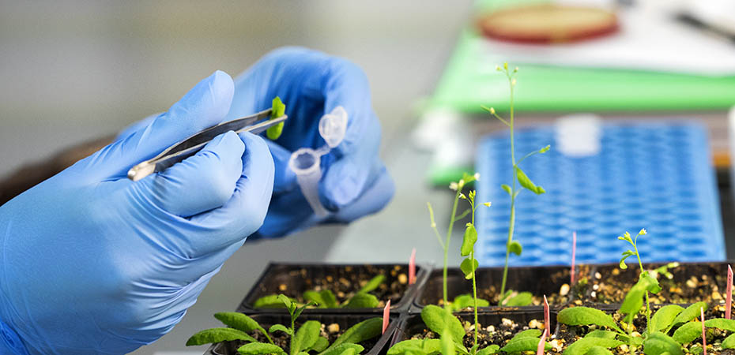
Exemptions to 16.1 (reliance on data)
the Government of Canada has published the data in a scientific journal or on a Government of Canada website;
the data is publicly available and is derived from a test that was not sponsored by or conducted by or on behalf of a person who manufactures, imports or sells the cosmetic;
the data is derived from a test that was conducted before the day on which this section comes into force;
the cosmetic was sold in Canada at any time before the day on which this section comes into force;
This presentation is not legal advice

Slide 3
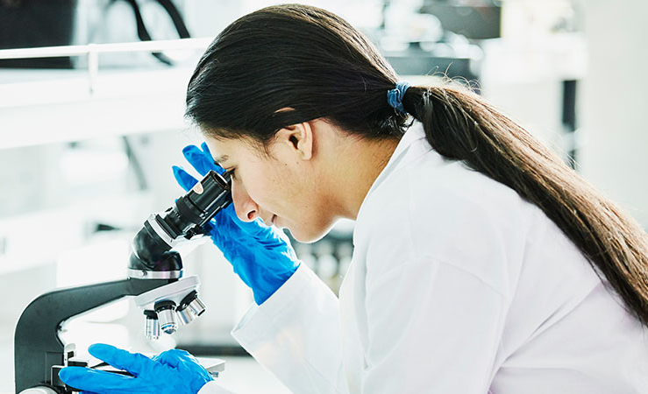
Exemptions to 16.1 (reliance on data)
the following conditions are met:
  (i) the data is derived from a test that was conducted on a substance in order to meet
    (A) a requirement under a provision of an Act of Parliament or any of its regulations that applied at the time that the test was conducted, except a requirement that relates only to cosmetics under a provision of this Act or the regulations, or
    (B) a requirement that does not relate to cosmetics under the law that applied in a
    foreign state at the time that the test was conducted,
  (ii) the substance is or has been used in a product that is not a cosmetic and that is
  or has been legally sold in the country where the requirement in question applied, and
  (iii) the test was necessary to meet the requirement in order to sell the product
  in that country;
  or
any prescribed circumstance applies.
This presentation is not legal advice

Slide 4
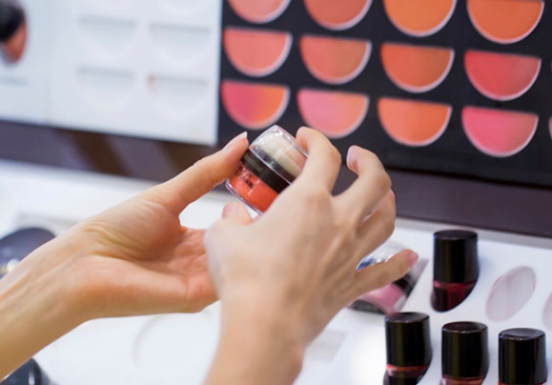
Food and Drugs Act
Regulations
New power to make regulations necessary for the purpose of preventing, in respect of cosmetics, the conduct of a test on an animal that could cause pain, suffering or injury, whether physical or mental, to the animal, or preventing the purchaser or consumer of a cosmetic from being deceived or misled in respect of whether the cosmetic was tested on animals.
Existing power to exempt any cosmetic, person or activity from
all or any of the provisions of the Act/regulations.
Coming into Force
Six months after royal assent – December 2023
This presentation is not legal advice

Slide 5

Marketing a New Cosmetic Product
Food and Drugs Act – Prohibition on sale
  Any substance that may cause injury to the health of the user when cosmetic is used according to directions/customary use
Cosmetic Regulations - Evidence of safety
  May request in writing that a manufacturer submit evidence to establish the safety of a cosmetic under recommended/normal conditions of use.
Resources
  Cosmetic Ingredient Hotlist - list of substances that are restricted or prohibited in cosmetics
  Government published risk assessments (e.g. Chemicals Management Plan)
  Data required to market other regulated products in Canada – e.g. Drugs, Natural Health Products, Consumer Products
Image: https://www.canada.ca/content/dam/hc-sc/documents/corporate/transparency/corporate-management-reporting/report-plans-priorities/2017-2018-report-plans-priorities.pdf
Presented by: Laura Gomez, Partner – laura.Gomez@gowlingwlg.com

